Slide 1
Why SDN and MPLS?
Saurav Das, Ali Reza Sharafat,
Guru Parulkar, Nick McKeown
Clean Slate CTO Summit
9th November, 2011

Slide 2
MPLS Services
Why do Service Providers use MPLS?
Really about 2 services
MPLS VPNs
MPLS - TE
Motivation
Highly profitable
No easy way
Older ways not used
Motivation
Deterministic Behavior
Efficient Resource Utilization
Older ways not used
Notes:
TE –traffic revise

Slide 3
What is Traffic Engineering?
Steering traffic to where the bandwidth is…
good for the traffic - less congestion
good for the network - better resource utilization
MPLS Solution:
Create tunnels routed over under-utilized parts of the network
Route traffic through the tunnels
Notes:
Going to show a video of how MPLS does traffic engineering TODAY.

Slide 4
Video of a Demonstration
showing MPLS-TE service with SDN/OF
www.openflow.org/videos

Slide 5
OSPF-TE
LDP
I-BGP
RSVP-TE
LMP
MP-BGP
Label Switched Path (LSP)
PUSH
SWAP
POP
Notes:
So this is how MPLS supports traffic-engineering today, And it does so using LSP in the data plane – push, pop, swap + a bunch of protocols in the control plane = together make the service come alive. And that is what you saw in the video. But not exactly – we retained the MPLS data plane but did not use any of these control plane protocols – replaced all of their functionality with OpenFlow + apps

Slide 6
Services
Network Applications
TE
Provide the Services without the Complexity!
Routing
Discovery
Label Distribution
Recovery
Simpler Control Plane
NETWORK OPERATING SYSTEM
OSPF-TE
LDP
I-BGP
OpenFlow
RSVP-TE
LMP
MP-BGP
Simpler
Data Plane
Label Switched Path (LSP)
P
PUSH
SWAP
POP
Notes:
But what do we mean exactly? What do we gain from this? Why bother?

Slide 7
Motivation
Distributed Network Functions
each with their own
State Distribution Mechanisms
State Distribution
Mechanisms
Distributed
Network Functions
PE Label Distribution
E-BGP learned Route Advert
VPN-IPv4 Route Advert
TE Label Distribution
IGP- Route Advert, Link-State
LDP
I-BGP + RR
MP-BGP
RSVP-TE
OSPFv2
Switch Operating System
MPLS doesn’t come cheap
MPLS additional feature on complex core-routers
Need to support many protocols
MPLS doesn’t come simple
IP/MPLS Control plane exceedingly complex

Slide 8
Motivation
Auto-Route
Auto-Bandwidth
Priorities
Load-Share
DS-TE
FRR
Re-opt
Auto-Route
Auto-Bandwidth
Priorities
Load-Share
DS-TE
FRR
Re-opt
Auto-Route
Auto-Bandwidth
Priorities
Load-Share
DS-TE
FRR
Re-opt
TE
TE
TE
LDP
I-BGP + RR
MP-BGP
RSVP-TE
OSPFv2
LDP
I-BGP + RR
MP-BGP
RSVP-TE
OSPFv2
LDP
I-BGP + RR
MP-BGP
RSVP-TE
OSPFv2
Juniper
Cisco
Brocade
3. Slow pace of Innovation

Slide 9
Providing MPLS Services with SDN/OF
Services / Network Applications
(3)
TE 2.0
Routing
Discovery
Label Distribution
Recovery
Simpler Control Plane
(2)
NETWORK OPERATING SYSTEM
OpenFlow
Simpler
Cheaper
Multi-Vendor
Data Plane
(1)
PUSH
SWAP
POP

Slide 10
Application/Service Viewpoint
3 Examples of SDN Benefits:
Programmability & Simplicity
Extensibility
Global -Optimization

Slide 11
Re-routing Packets into Tunnels
R3
R4
R2
R6
R5
R1
Exposing tunnels to OSPF or IS-IS
N² problem
Strictly avoided

Slide 12
Re-routing Packets into Tunnels
R3
R4
R2
R6
R5
R1
PBR/FBF,
AutoRoute
TE-LSP routing (CSPF)
Tunnels not
Represented
here
IP routing (SPF)
Link-state: cost, up/down
Link-state: cost, up/down
TE-Link-state: weight, attributes, reservations

Slide 13
AutoRoute
R3
R4
R2
R6
R5
R1
Routing Table in R5
Destination Router | Next-Hop | Total-Cost
R4 | R4, OutIntf 12 | 10
R6 | R6, OutIntf 9 | 10
R2 | R4, OutIntf 12 | 20
R2 | R6, OutIntf 9 | 20
Destination Router | Next-Hop | Total-Cost
R4 | R4, OutIntf 12 | 10
R6 | R6, OutIntf 9 | 10
R2 | TunnIntf T1 | 20

Slide 14
AutoRoute
IP dest-prefix
Policy Based Routing
IP dest-prefix
via dest-router
(in domain)
via dest-router
(in domain)
next-hop
next-hop
next-hop is tunnel
Header-field-match
next-hop is tunnel
or something else
Automated but Inflexible
Flexible but
Not Automated

Slide 15
SDN based Routing
Static-routes, PBR/FBF,
Autoroute
TE-LSP routing (CSPF)
IP routing (SPF)
Link-state: cost, up/down
Link-state: cost, up/down
TE-Link-state: weight, attributes, reservations
Default SPF Routing
VoIP traffic Routing
Customer traffic Routing
Load Sharing
Tunnels
Represented
here
Programmability =>
Flexibility + Automation
TE-LSP Routing
(CSPF)
IP network

Slide 16
Controller Internals
~4000 Lines-of-Code
Controller
Traffic-type Aware Routing
Default SPF Routing
Load Sharing
Packet-flow Routing Applications
Network API
TE-LSP Configuration Bw. Res. & Priorities
TE-LSP Routing (CSPF)
TE-LSP Statistics & Auto-Bandwidth
TE Applications
Network API
GUI
(ENVI)
GUI
API
(LAVI)
Switch-
API
IP Topology
Label DB
TE tunnel DB
Packet-flow DB
Map Abstraction
Link Discovery
NOX core
(Connection Handler, Event engine)
To switches..
OpenFlow protocol

Slide 17
Application/Service Viewpoint
3 Examples of SDN benefits:
Programmability & Simplicity
Extensibility
Global -Optimization

Slide 18
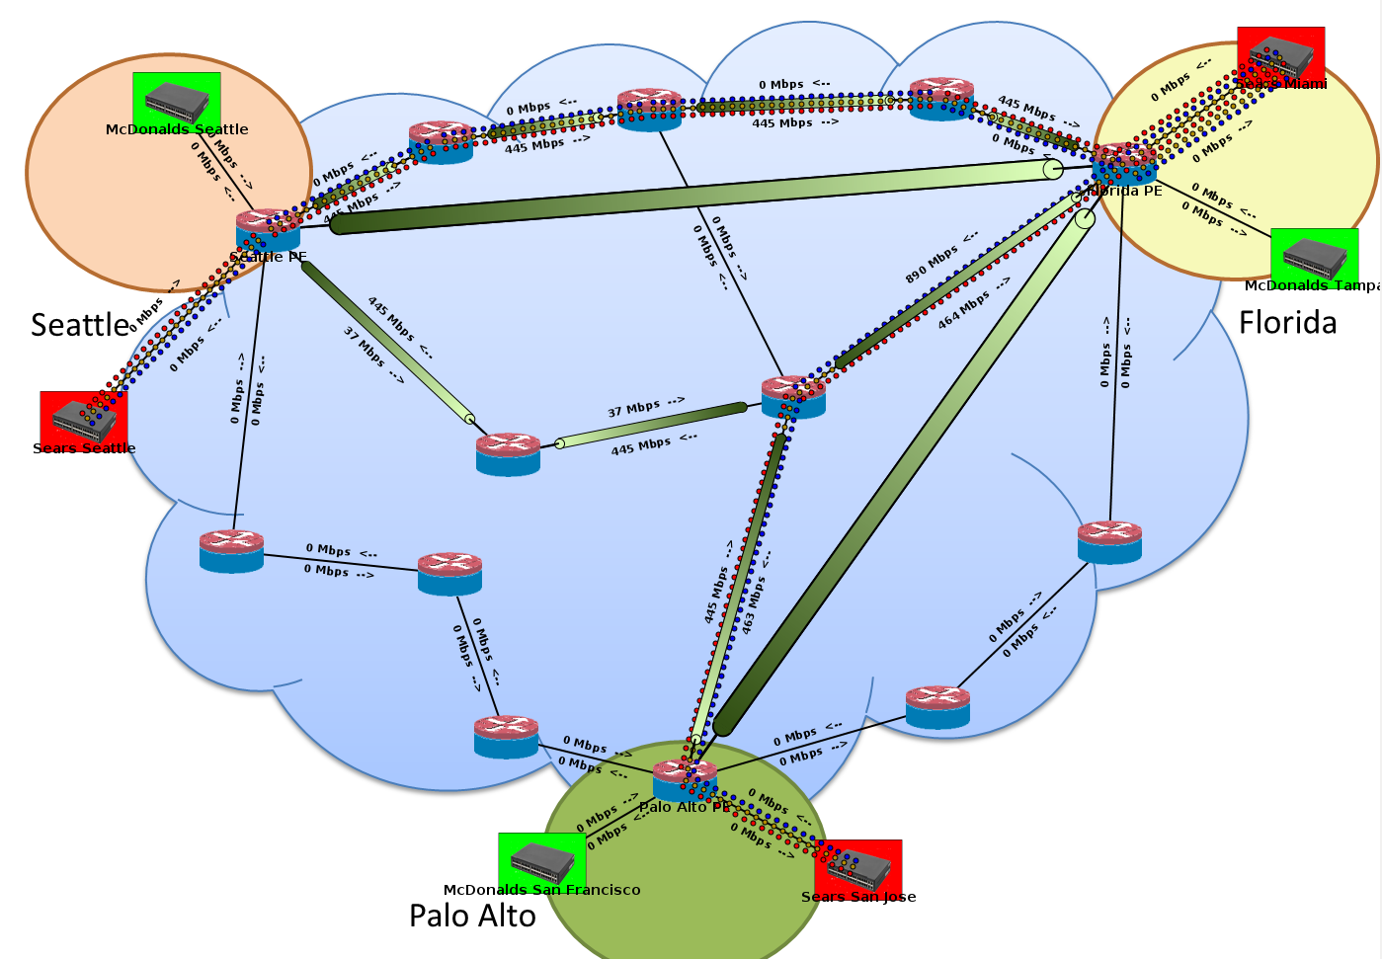
L3-VPN

Slide 19
What would it take in today’s networks?
2 new protocols – LDP and MP-BGP
Implementation in each router
More code to tie VPN service to protocols
… and protocols to other protocols
CLI changes + configuration
… and eventually standardization

Slide 20
What did it take with SDN?
Just this!!
Controller
Traffic-type Aware Routing
Default SPF Routing
VPN Routing
Packet-flow Routing Applications
Network API
TE-LSP Configuration Bw. Res. & Priorities
TE-LSP Routing (CSPF)
TE-LSP Statistics & Auto-Bandwidth
TE Applications
Network API
GUI
(ENVI)
GUI
API
(LAVI)
Switch-
API
IP Topology
Label DB
TE tunnel DB
Packet-flow DB
Map Abstraction
Link Discovery
NOX core
(Connection Handler, Event engine)
To switches..
OpenFlow protocol

Slide 21
Providing MPLS Services with SDN/OF
Services / Network Applications
(3)
TE 2.0
VPNs 2.0
Optimized FRR/ AutoBw
MPLS-TP Control
Multi-layer Control
Routing
Discovery
Label Distribution
Recovery
Simpler Control Plane
(2)
NETWORK OPERATING SYSTEM
OpenFlow
Simpler
Data Plane
(1)
PUSH
SWAP
POP
Notes:
Existing services = Simpler dynamic optimized + new services

Slide 22
Application/Service Viewpoint
3 Examples of SDN Benefits:
Programmability & Simplicity
Extensibility
Global -Optimization

Slide 23
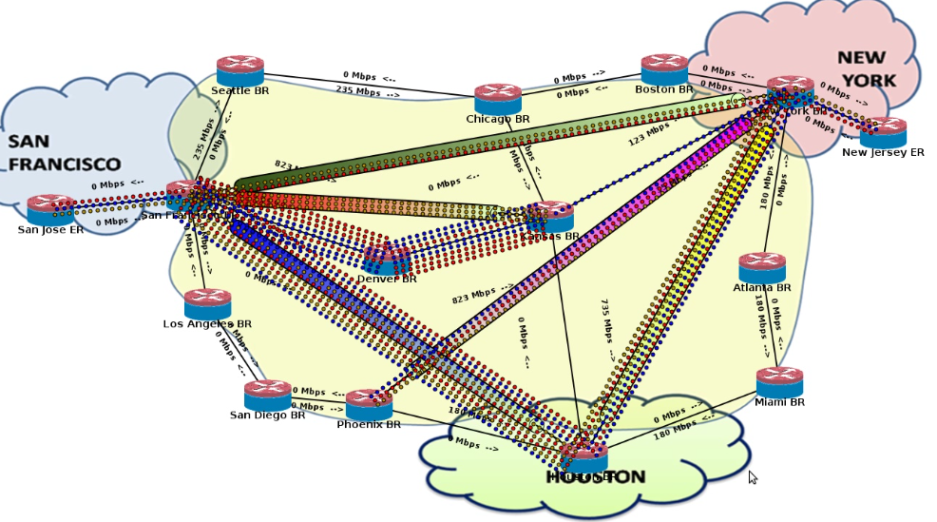
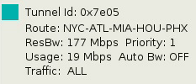
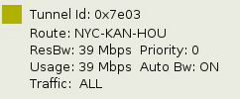
Auto-Bandwidth/ Re-Opt Timers

Slide 24
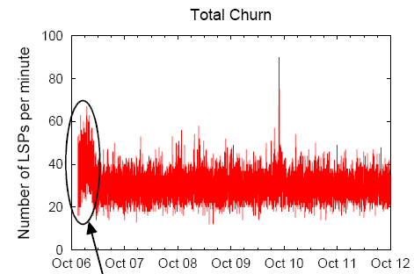
Churn
R3
R4
R2
R6
R5
Local View → Local Optimization
Source: NANOG 24

Slide 25
Global View →Global Optimization
Periodic,
Online
Global-Opt
TE 2.0
VPNs 2.0
Optimized FRR/ AutoBw
MPLS-TP Control
Multi-layer Control
Routing
Discovery
Label Distribution
Recovery
NETWORK OPERATING SYSTEM
OpenFlow
2. Dynamically Update Forwarding State
PUSH
SWAP
POP
Notes:
No churn

Slide 26
Simpler Control – Eliminate protocols, decouple network-functions from state-distribution mechanisms
Service Innovation – Programmability, Extensibility & Global-Optimization.
Simpler, Cheaper MPLS data-plane with SDN control-architecture
Why SDN and MPLS?

Slide 28
Prototype System
MPLS-TE
Auto – route; Auto – bandwidth
Traffic – aware LSPs; Priorities
TE-LSP configuration
MPLS GUI
MPLS API
CSPF Routing
MPLS Stats
GUI (Envi)
showing real-time
network state
Network Operating System (NOX)
OpenFlow
Open vSwitch
with standard MPLS data plane
Open vSwitch
(with MPLS)
Open vSwitch
(with MPLS)
Open vSwitch
(with MPLS)
Open vSwitch
(with MPLS)
Open vSwitch
(with MPLS)
Open vSwitch
(with MPLS)
Open vSwitch
(with MPLS)
Open vSwitch
(with MPLS)
Open vSwitch
(with MPLS)
Open vSwitch
with standard MPLS data plane
Mininet Environment

