Slide 1
The Ten Golden Principles For Successful Web Apps
http://www.flickr.com/photos/goldmoneynews/4359595728/

Slide 2
Speed
http://www.flickr.com/photos/smifcouk/100994583/

Slide 3
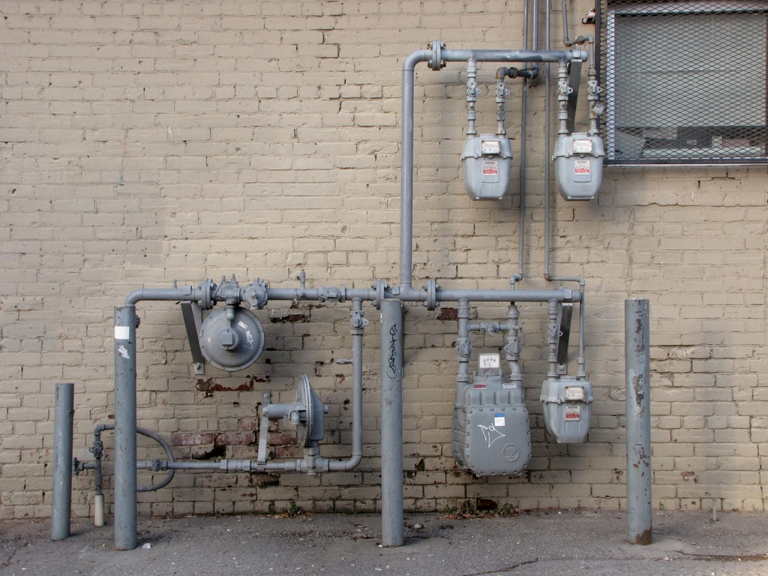
Instant Utility
http://www.flickr.com/photos/drew_makepeace/4303280136/

Slide 4
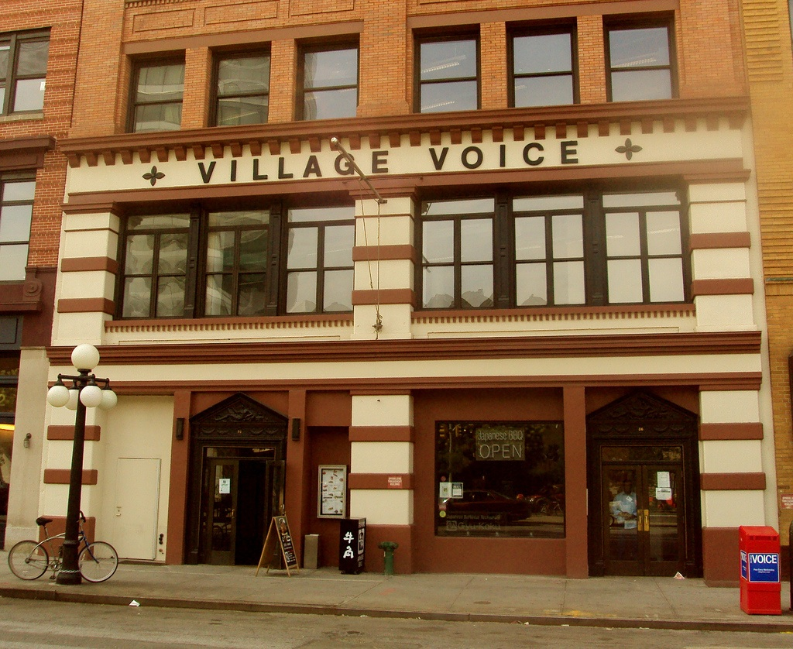
Voice
http://www.flickr.com/photos/bitchcakes/3802145158/

Slide 5
Less Is More

Slide 6
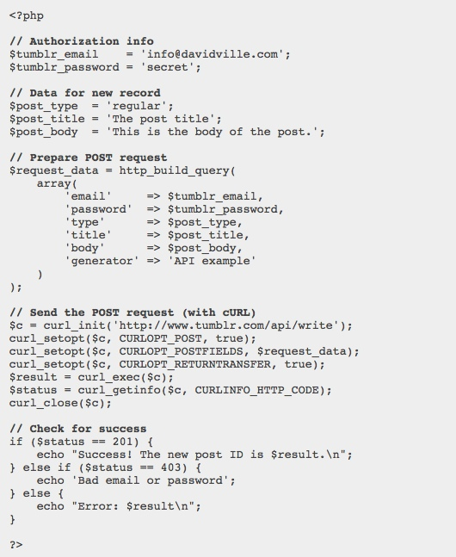
Programmable

Slide 7
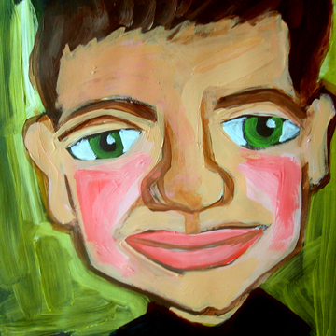
Personal

Slide 8
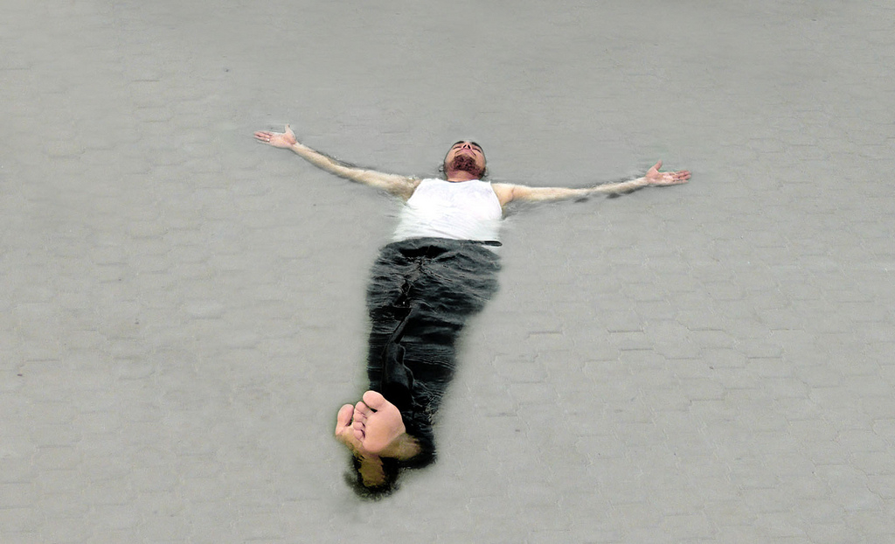
RESTful
http://www.flickr.com/photos/38283735@N07/4074050651/

Slide 9
Discoverable
http://www.flickr.com/photos/mayaevening/138372058/

Slide 10
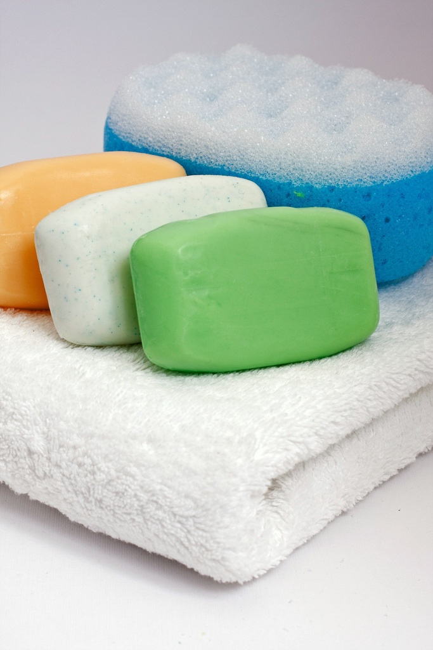
Clean
http://www.flickr.com/photos/horiavarlan/4263958356/

Slide 11
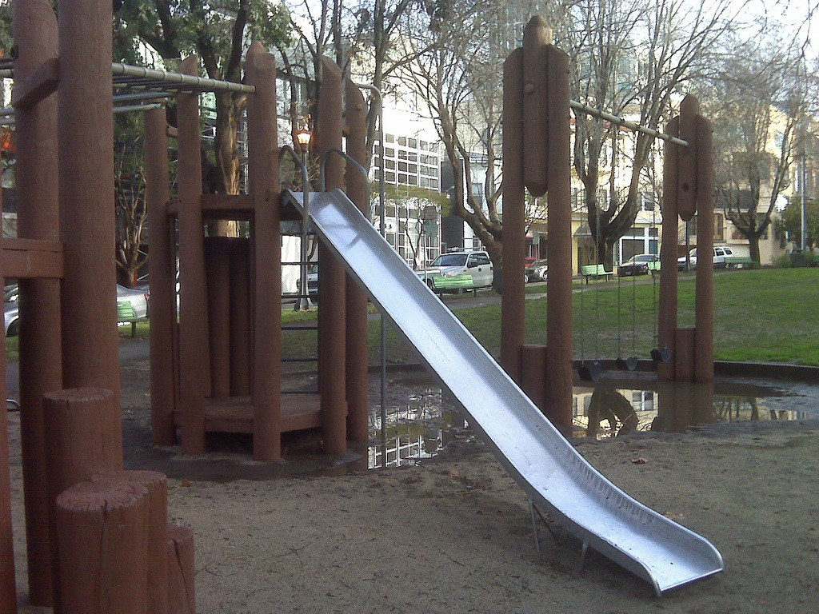
Playful

